Slide 1



Anal fistula: minimal invasiveness or maximum confusion?
Francesco Ferrara
Dip. Me.pre.c.c.
Università di palermo
u.o. Chirurgia generale e oncologica
Policlinico «paolo giaccone» palermo
Segretario generale siccr

Slide 2
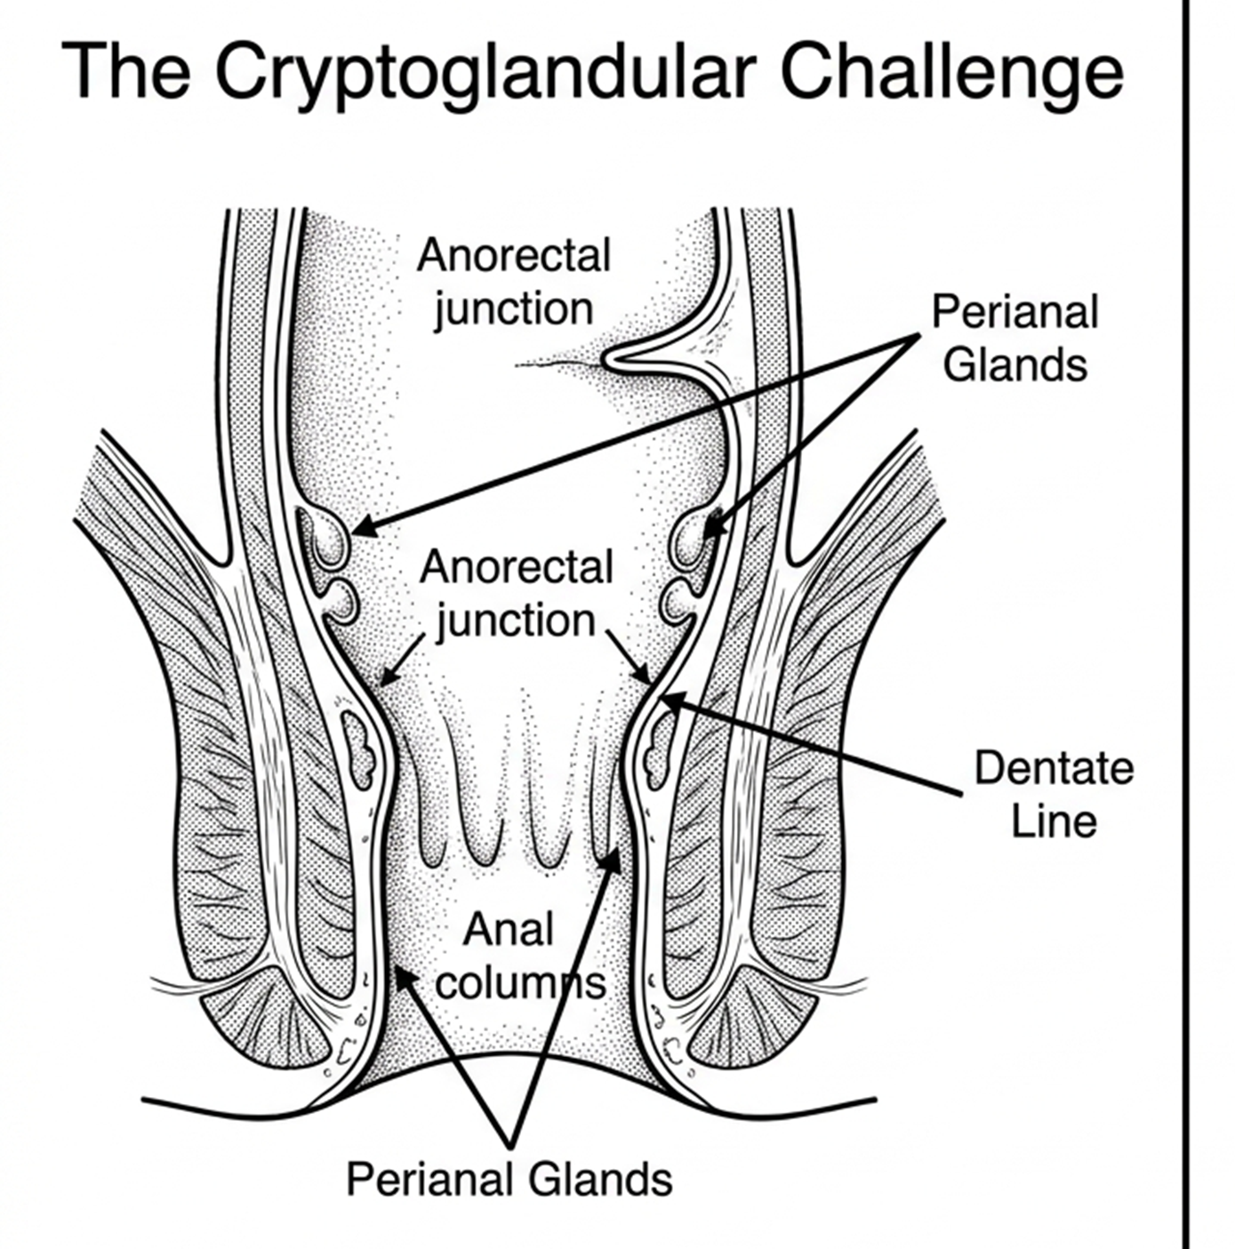
Incidence
8.6 – 10 per 100.000 population annually
Etiology
Predominantly cryptoglandular origin (Gosseling et al. 2015), originating in the perianal glands at the detntate line
Clinical Burden
High economic and psychosocial impact due to recurrent pain, purulent discharge, and the protracted nature of healing

Slide 3
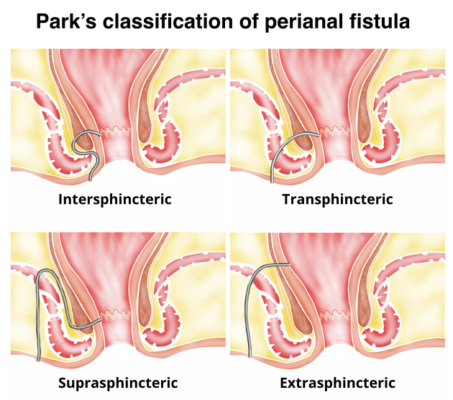
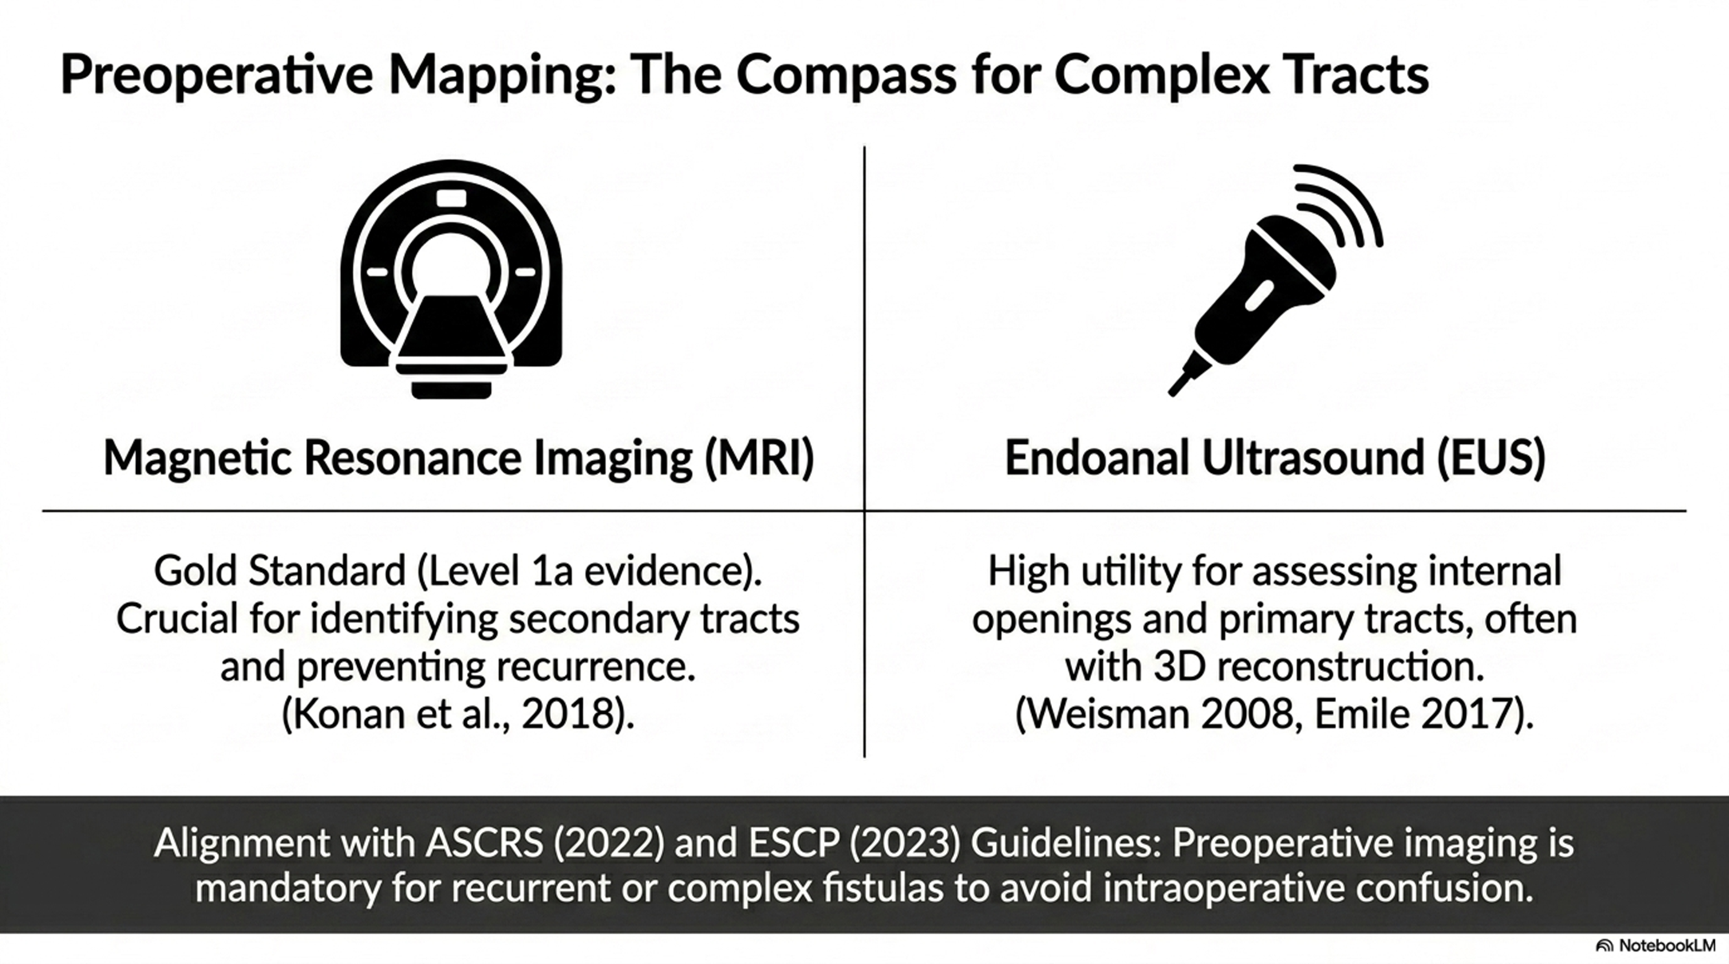
N.B. Modern standard mandates the execution of accurate preoperative mapping via EAUS or MRI for complex cases to determine sphincter involvement
45%
30%
ASCRS (2022) and ESCP (2023) guidelines: preoperative imaging mandatory for recurrent or complex fistulas
20%
5%

Slide 4
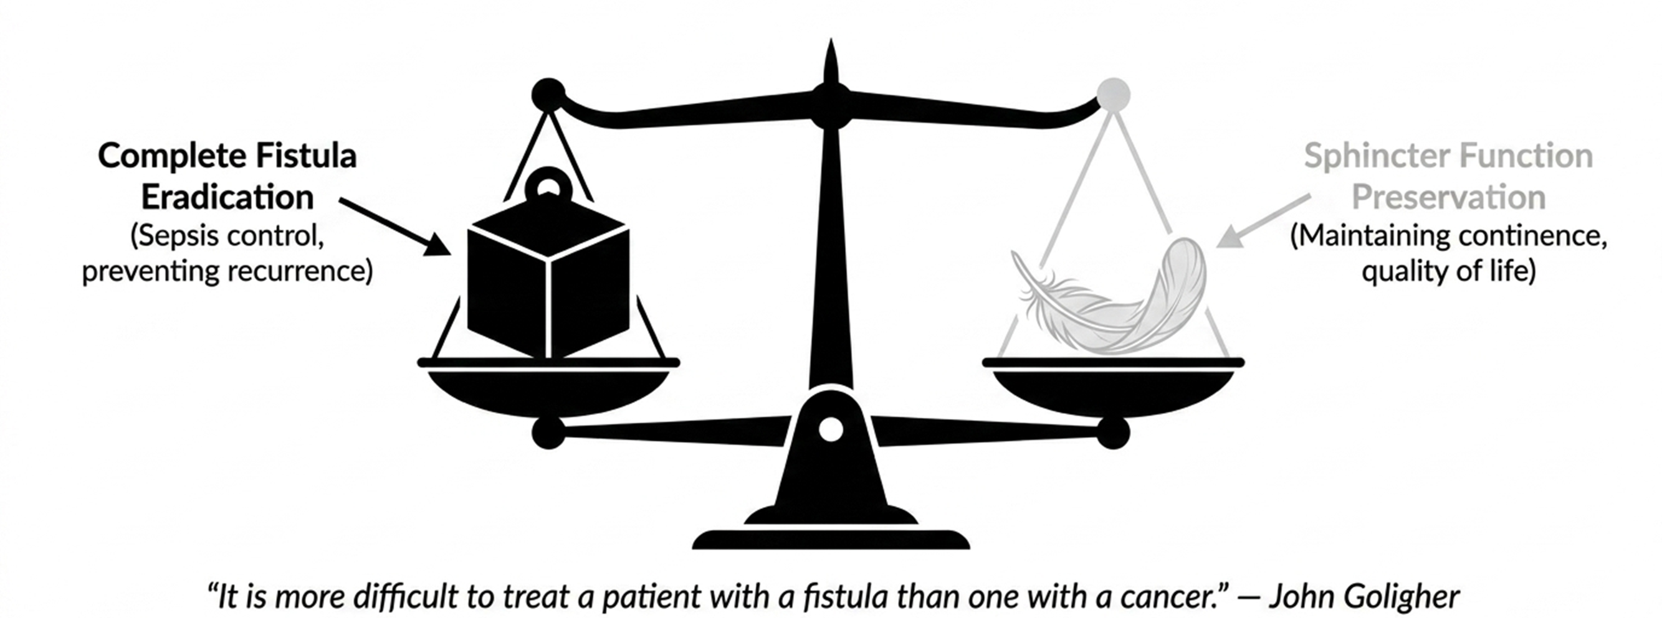
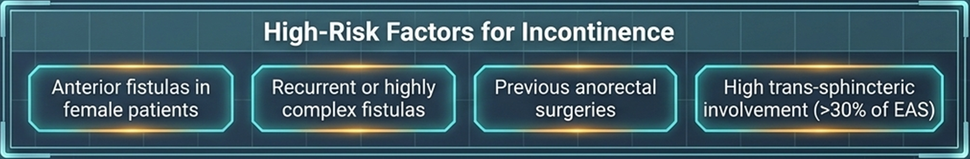
The Surgical Dilemma – Healing vs. Continence

Slide 5
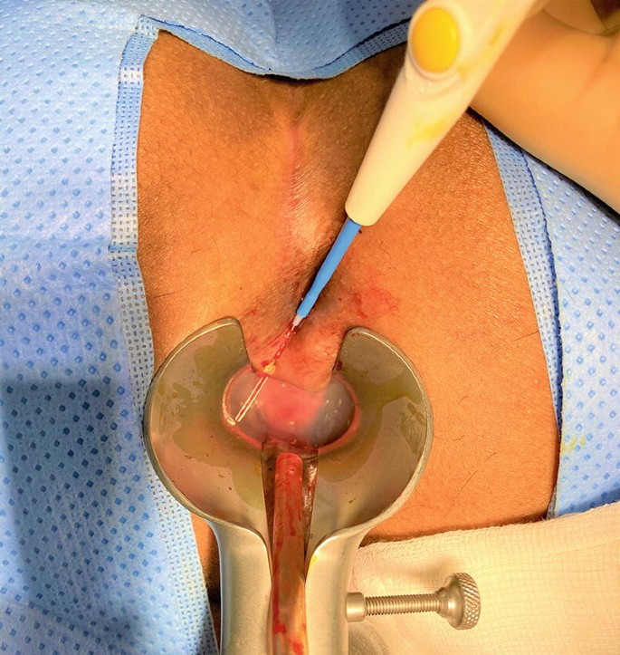
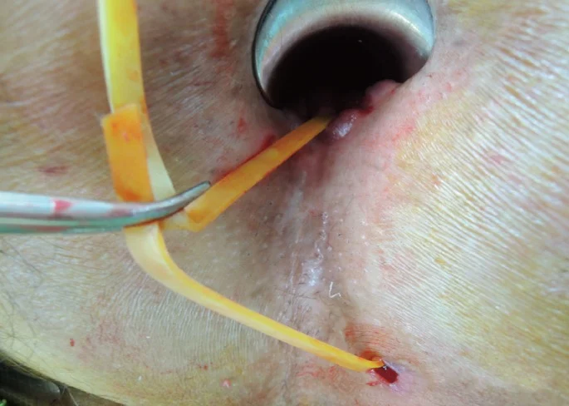
Traditional management remains uncontested for simple fistulas
Fistulotomy (gold standard)
Draining seton
Efficacy: > 90% healing success
Guidelines: ASCRS & ACPGBI recommend for simple, low fistulas
Function: safe bridge to staged repair
Benefit: resolves acute sepsis and prevents premature closure
Unacceptable incontinence risk for complex tracts crossing >30% of the EAS
Rarely curative as a standalone definitive procedure

Slide 6
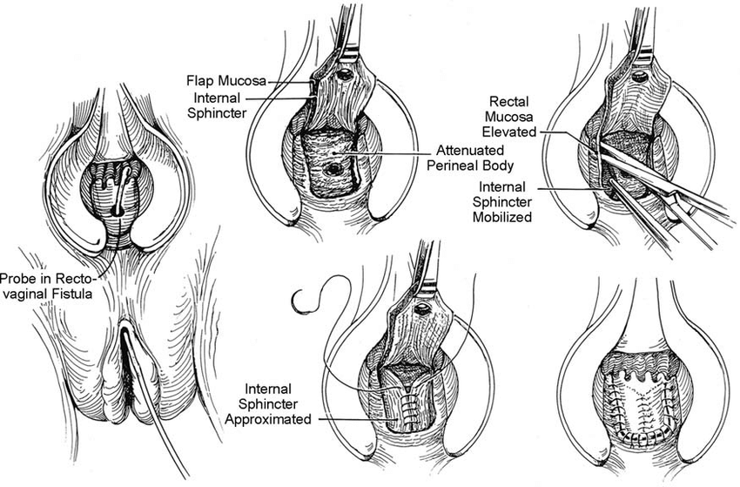
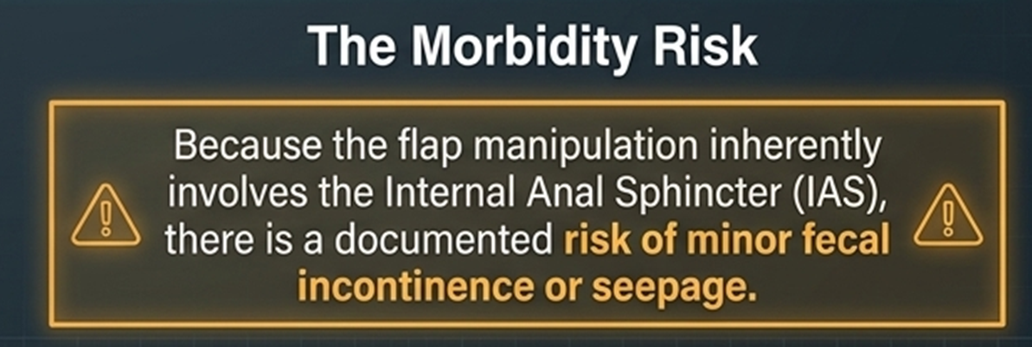
Advancement Flaps introduce the risk of sphincter manipulation
Mechanism
Mobilizing tissue (mucosa or skin) to cover the internal opening.
Healing Rate: 60-87%.
Advantage: Intact perianal sensation and no damage to the distal sphincter.

Slide 7
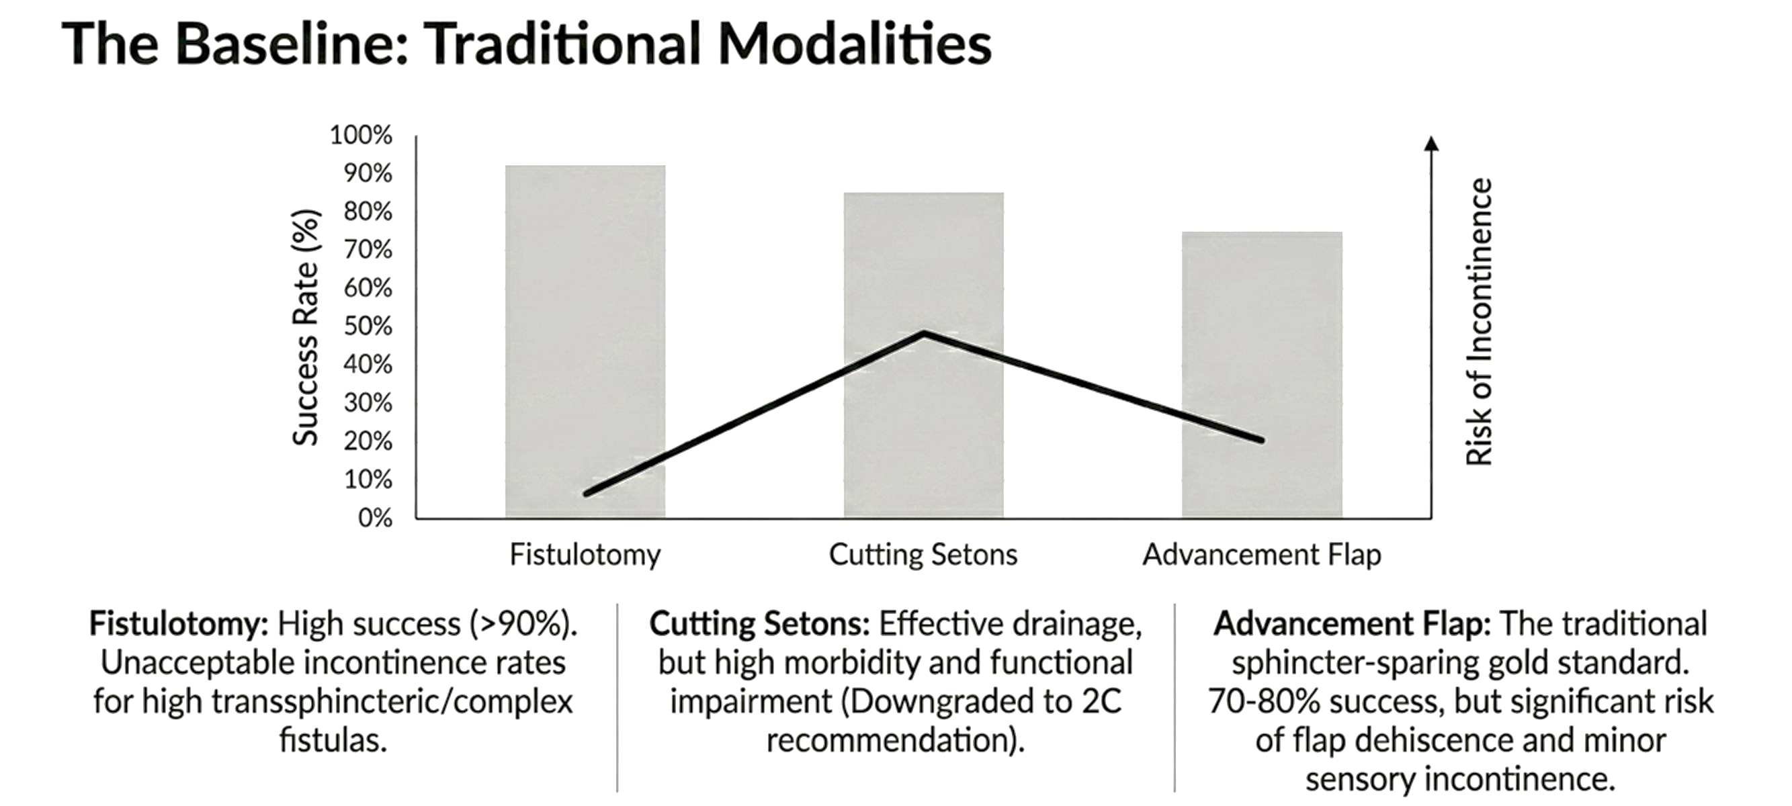
High efficacy, but anatomical cost is too steep for complex disease

Slide 8
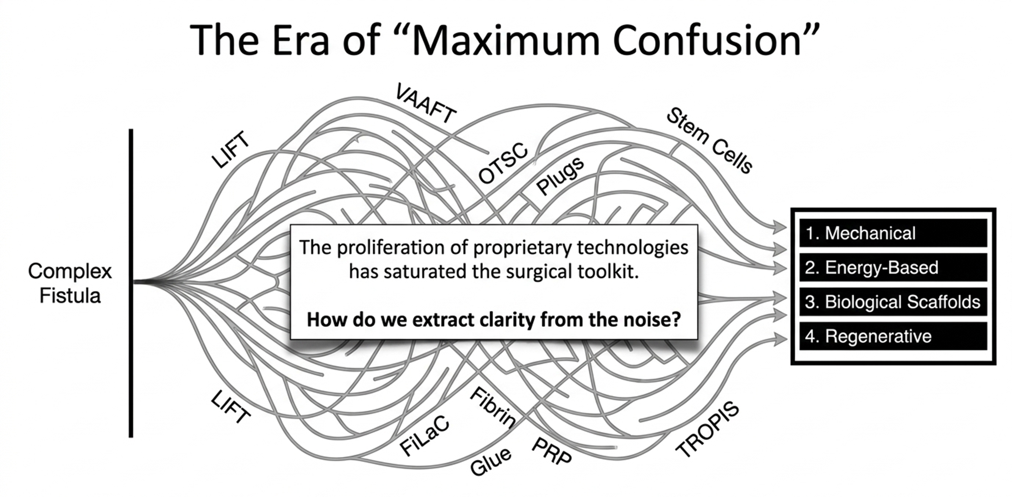

Slide 9
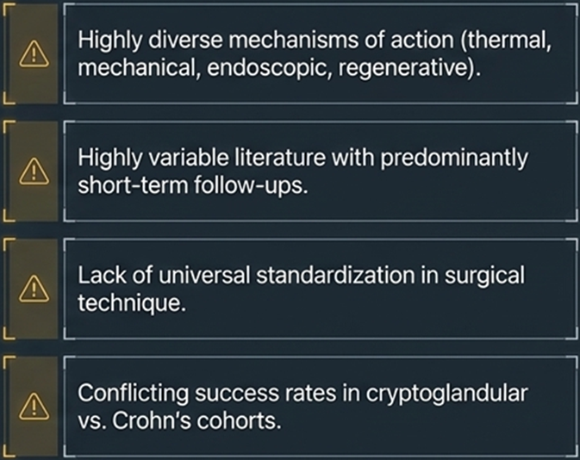
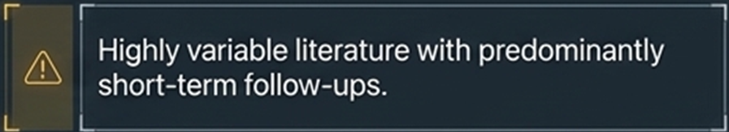
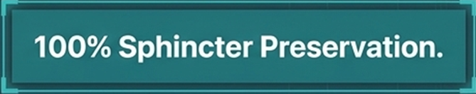
The explosion of technologies has created a cluttered landscape
Shift toward "Sphincter-Saving" procedures to protect functional outcomes.
A plethora of new techniques but high heterogeneity in success rates and study quality.
“Maximum confusion”
The goal:

Slide 10
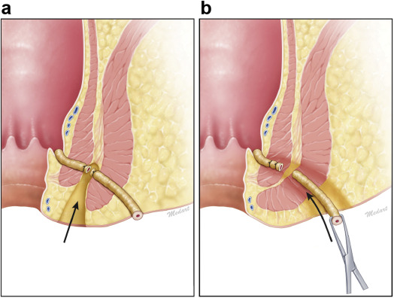
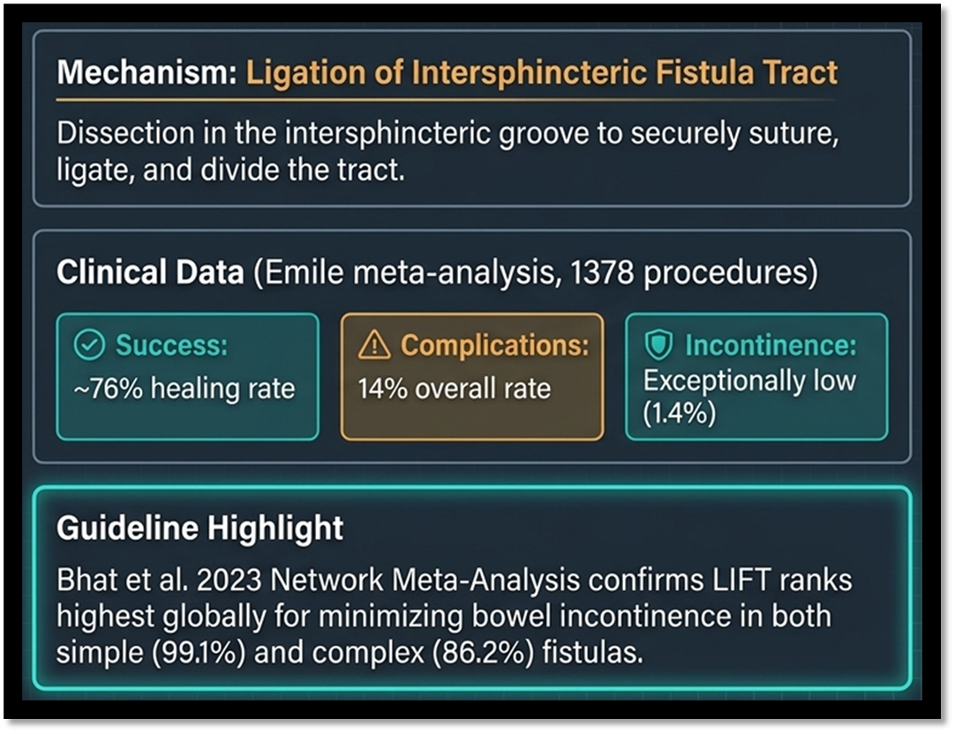
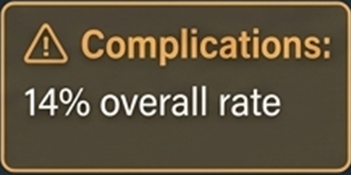
LIFT: Ligation of Intersphincteric Fistula Tract
• Introduced by Rojanasakul in 2007.
• Technique: Approaching and ligating the tract through the intersphincteric space, keeping the EAS intact.
• Ideal for: Trans-sphincteric fistulas.
• Success Rate: 70-80% in uncomplicated cases.
Network Meta-analysis (Bhat et al. 2023): LIFT ranked best for minimizing bowel incontinence in both simple (99.1% probability) and complex fistulas (86.2%).
Recommended by many global guidelines (German, ASCRS) as a first-line option for high fistulas

Slide 11
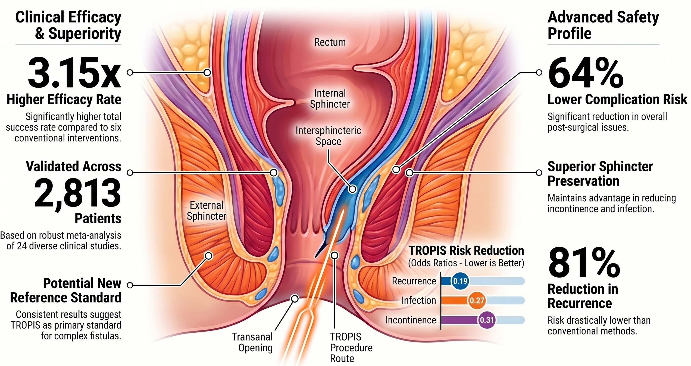
TROPIS: TRansanal OPening of the Intersphincteric Space

Slide 12
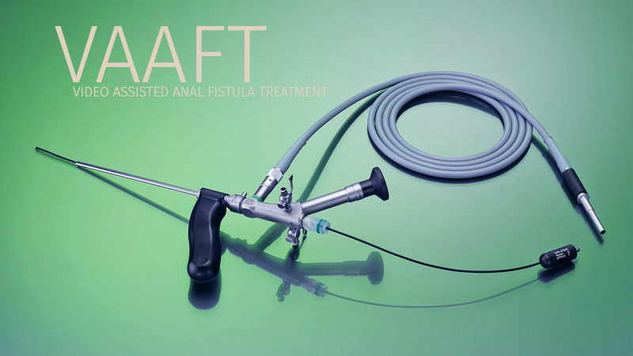
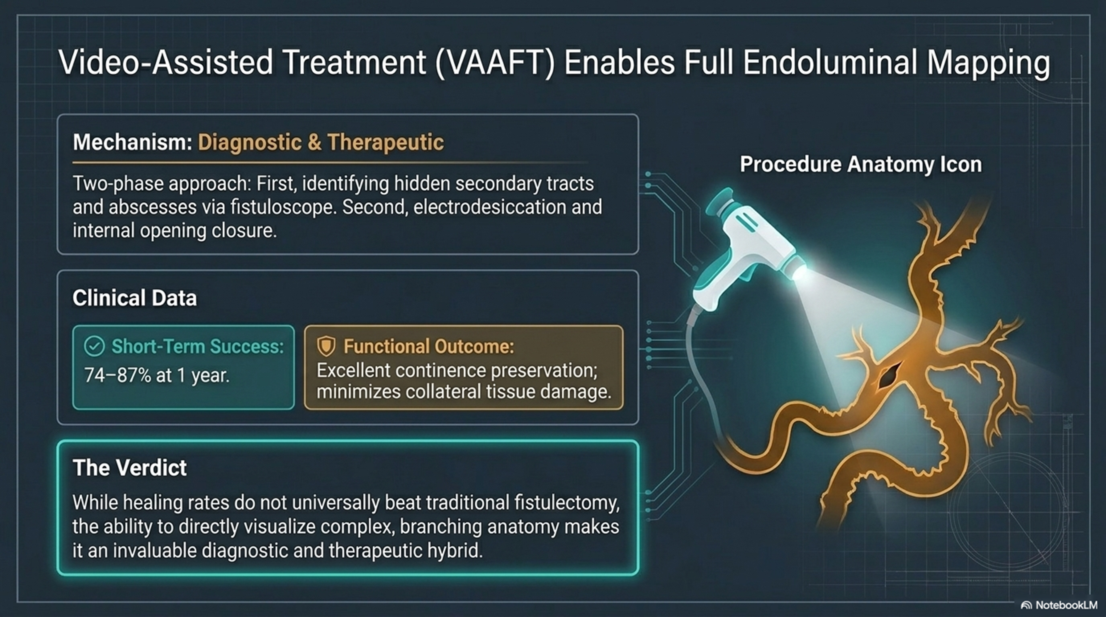
VAAFT: Video-Assisted Anal Fistula Treatment
• Introduced by Meinero in 2011.
• Technique: Endoscopic visualization of the tract; electrodesiccation of the wall; closure of the internal opening → Diagnostic and Therapeutic
• Strengths: Identifies secondary branches and avoids large wounds.
• Weakness: Inflexible scope may struggle with complex curvatures.
• Some trials have noted high recurrence rates in complex cases (up to 65% at 6 months).
Healing rates do not beat traditional fistulectomy, however this is a good diagnostic and therapeutic option. Long-term results are highly dependent on internal opening closure

Slide 13
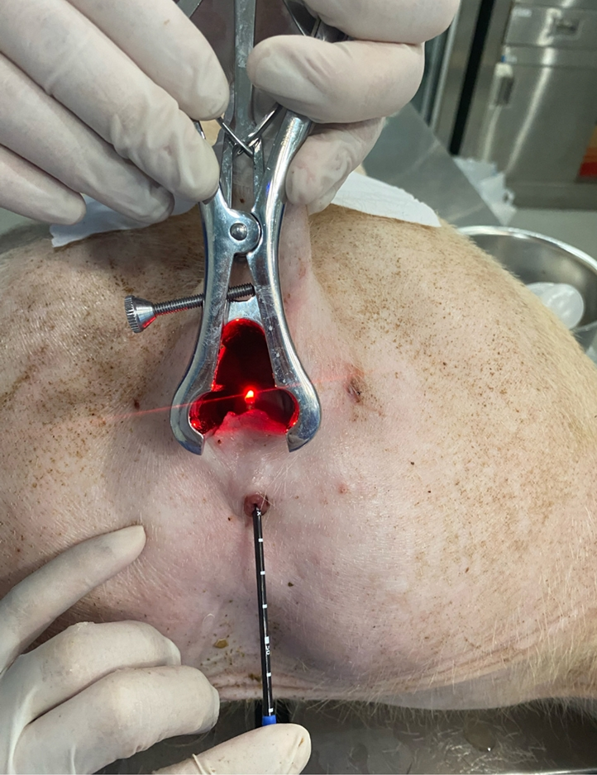
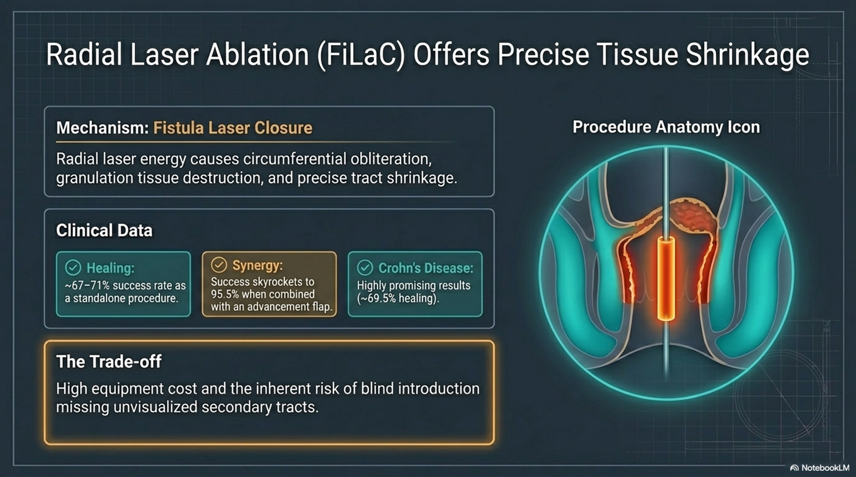
FiLaC – Fistula Laser Closure
• Radial laser energy causes tract obliteration through a shrinkage effect.
• Functional Benefits: Minimal pain and short hospital stay.
• Limitations: Higher recurrence compared to fistulotomy with primary sphincteroplasty. No direct visualization.
High equipment cost
Missing unvisualized secondary tracts

Slide 14
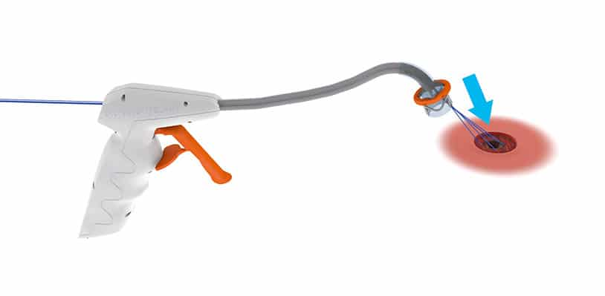
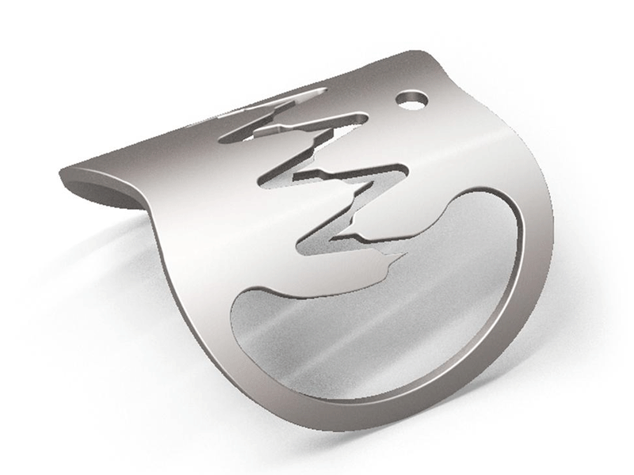
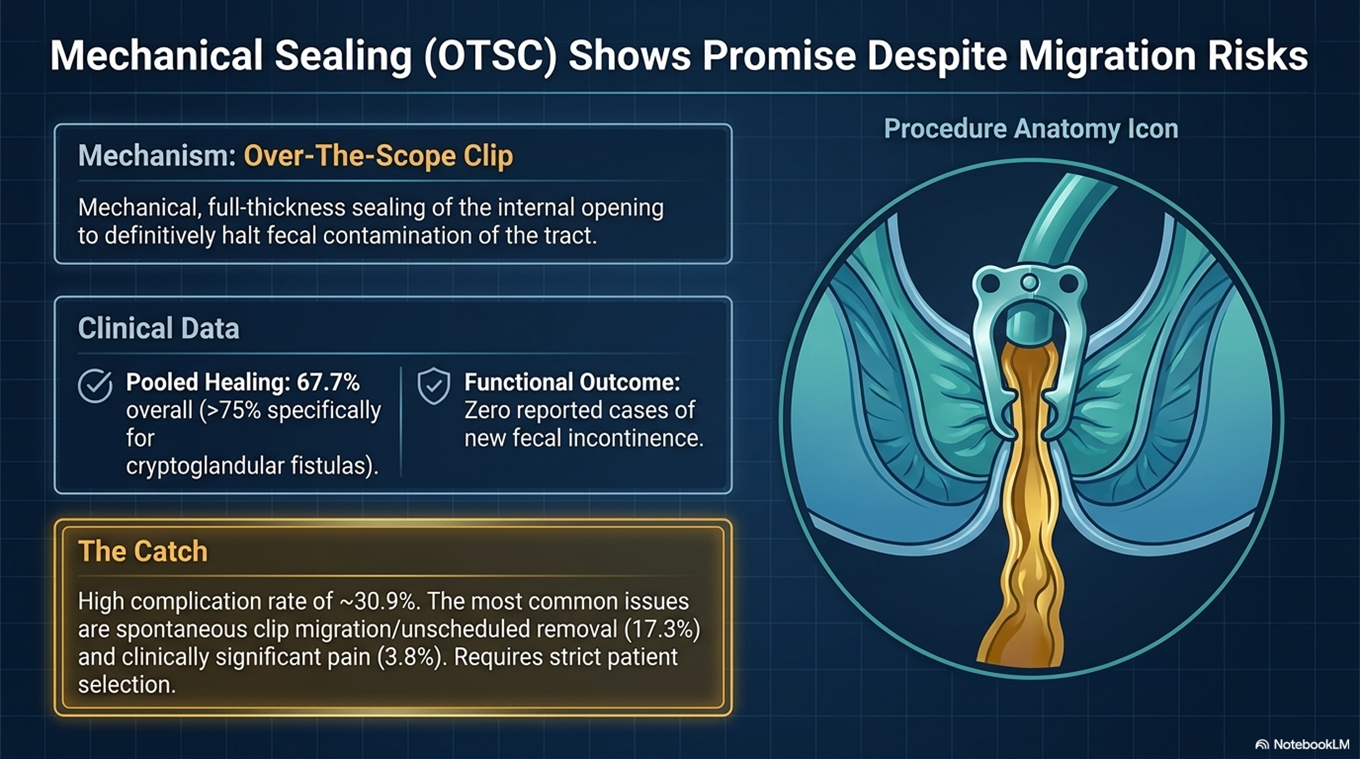
OTSC – Over-The-Scope Clip
• Nitinol clip used to mechanically seal the internal opening transanally.
• Meta-analysis (Lu et al. 2025): Overall healing rate of 67.7% (up to 78.7% for idiopathic cases), at a median follow-up of 11.3 months
• Complication Rate: ~31% (mostly spontaneous clip migration).
• Incontinence: No reported cases in several studies.

Slide 15
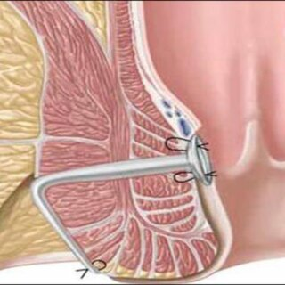
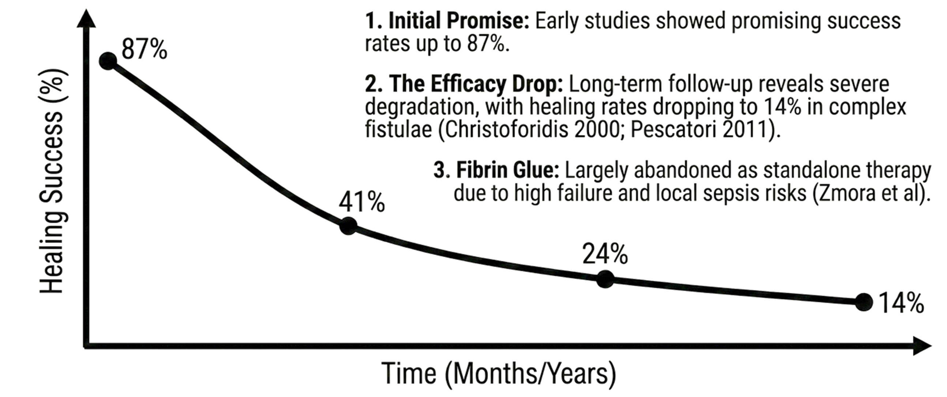
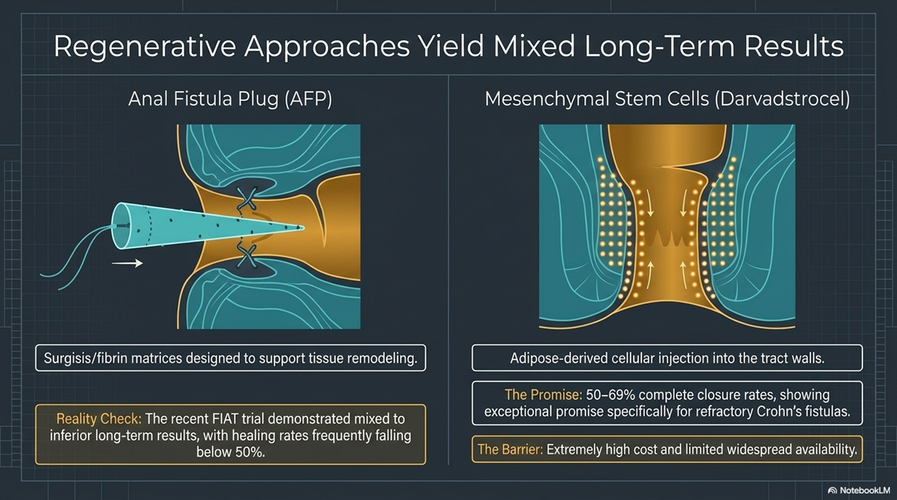
Regenerative Frontiers – Anal Fistula Plugs (AFP) and Fibrin Glue
Risk of plug migration or extrusion

Slide 16
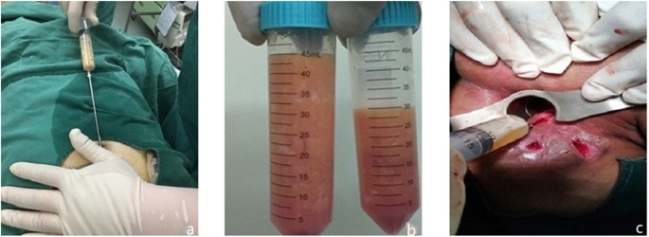
Regenerative Frontiers – Stem Cell Therapy
• Mesenchymal Stem Cells (MSCs) from adipose tissue or bone marrow injected into the tract wall.
• ADMIRE-CD Trial (2016): 50% remission rate in complex Crohn's fistulas → Long-Term Results: Healing has been shown to be maintained for up to 3 years in 60% of patients with refractory Crohn’s disease.
• Efficacy: Success rates of 50-60% in refractory cases.
• Guidelines: Listed as a second-line treatment for complex fistulas in ESCP 2023 guidelines.

Slide 17


Comparing the Evidence – Short vs. Long Term
• Short-term success (≤6 months): No significant difference in healing rates between LIFT, Flap, and Plugs in complex cases.
• Long-term success (>6 months): LIFT remains a strong performer in complex fistulas (92.3% ranking probability).
• Consistent Message: MIS techniques offer superior functional protection, but traditional fistulotomy remains the most reliable for healing simple fistulas.
Consensus: Simple fistulas should be treated with fistulotomy.
Divergence: Attitudes toward LIFT vary; some guidelines strongly endorse it as first-line for high fistulas (German S3), others remain conservative due to lack of long-term RCTs (ESCP).
Controversial: Cutting setons and fibrin glue are being phased out or downgraded in newer recommendations

Slide 18
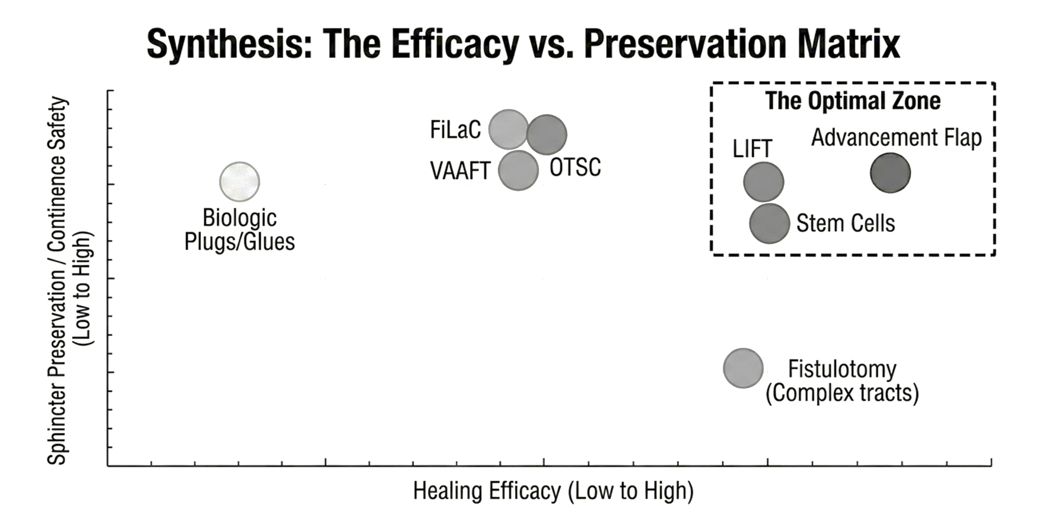

Slide 19
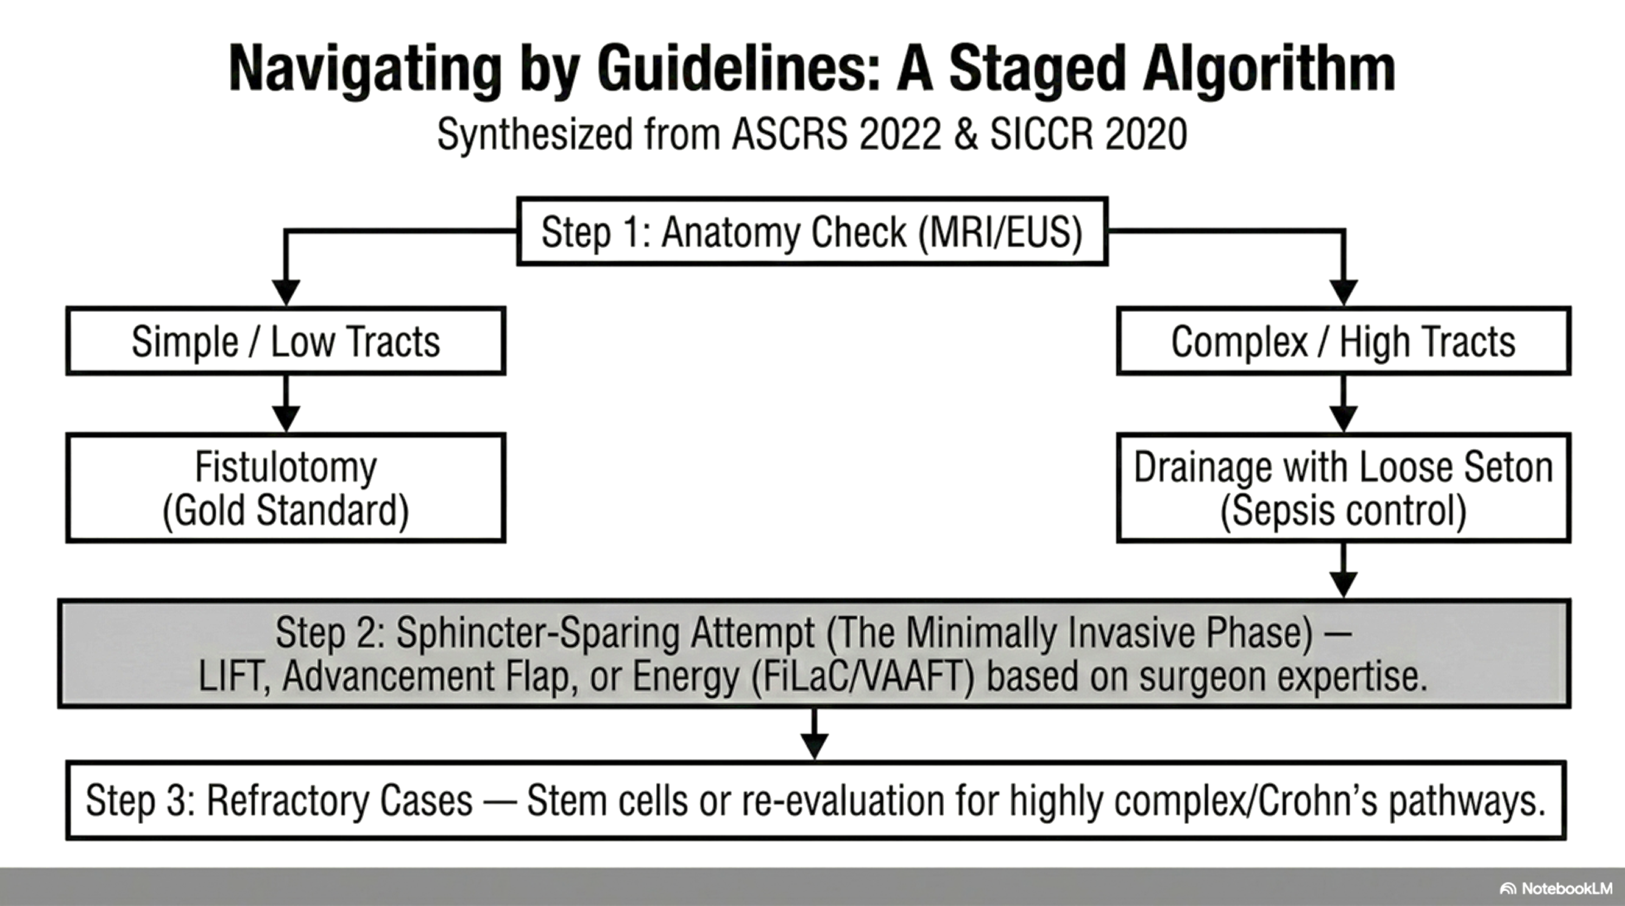

Slide 20
Conclusion: Minimal Invasiveness or Maximum Confusion?
Minimal Invasiveness: Clearly achievable with LIFT, VAAFT, FiLaC, and Stem Cells, offering near-zero incontinence risk.
The Confusion: High variability in definition, classification, and success criteria in literature.
Clinical Takeaway: Procedure choice must be tailored to anatomy, etiology (Crohn's?), and patient preference.
No single innovative, minimally invasive technique universally beats traditional fistulotomy for absolute healing
However, sphincter-preserving techniques vastly outperform traditional excisions in continence preservation

Slide 21
Grazie

